Slide 1


OSLO Air and Water:
Workshop 3
Welcome!
Thursday March 4th 2021
Virtual working group – Microsoft Teams

Slide 2

Purpose of today
TW2 Github issues
Changes to the Core - Air - Water Models
Attributes
First round of definitions

Slide 3
Agenda
Topic | Time (mins) | Timestamps
Start TW2 | 5 mins | 13:05
Introduction & Who’s in the room | 5 mins | 13:10
TW2 Github Issues | 30 mins | 13:40
Changes to the models since TW2 | 10 mins | 13:50
Break | 10 mins | 14:00
Brainstorm exercise Attributes | 60 mins | 15:00
Validation Definitions | 10 min | 15:15
Next Steps | 5 min | 15:30

Slide 4



Practicalities
Audience sound is muted by default
Use your hand if you want to say something. Interaction is encouraged!
Video camera encouraged
Questions, comments and suggestions can be communicated via the chat function. Interaction is encouraged!
yes/no questions can be answered via chat:
Agree = +1
Do not agree = - 1
Indifferent = 0

Slide 5
Welcome and introduction

Slide 6
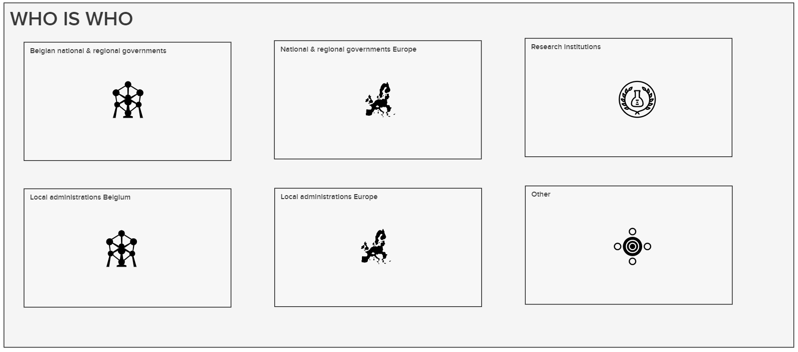
Who’s in the room?
5’
https://app.mural.co/t/beadvtc7549/m/beadvtc7549/1617019110779/e542a4d6a6ea51377ef244c8368b807413edc533

Slide 7
TW2 Github issues
Poposed solutions

Slide 8

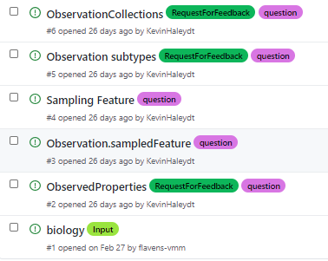
5 identified issues on github
1
ObservedProperties (link)
2
SampledFeature (link)
3
Sampling Feature (link)
4
Observation subtypes (link)
5
ObservationCollections (link)

Slide 9
1
observedProperties
Solution:
Ability to link to URI (from codelist)
Availability of a free text field in case property is not available
We specify the prefered codelists to use
Wikidata as it includes substances found in PubChem as well as DarwinCore + provides respective ids of PubChem, DarwinCore, CAS, ...
“Indicate a standardized codelist to use but leave the flexibility to define other properties should they not be present in the codelist that is proposed.”
Codelists that were proposed during the workshops
Proposed lists | AIR | WATER | Bio?
CAS | X | X
PubChem | X | X
WISE |  | X
Darwin Core - GBIF |  | X | X
Wikidata | X | X | X

Slide 10
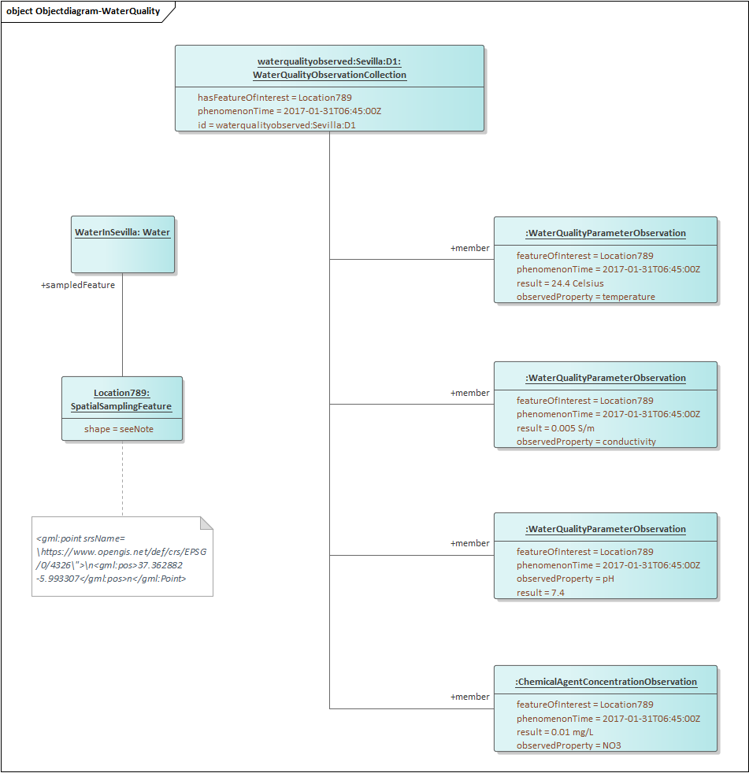
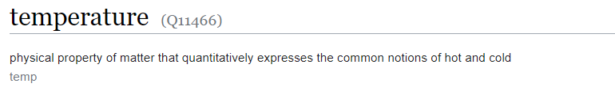
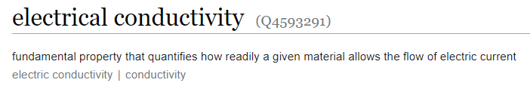
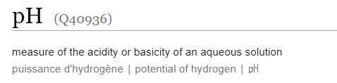
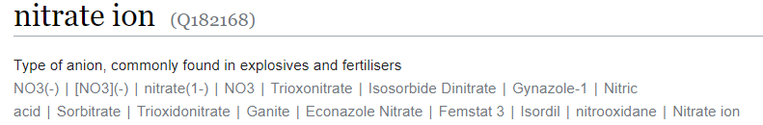
1
observedProperties
Solution:
Using wikidata URI allows to link to specific ObervableProperties (physical, chemical & biological)
Link to URIs from other
https://www.wikidata.org/wiki/Q11466
https://www.wikidata.org/wiki/Q4593291
https://www.wikidata.org/wiki/Q40936
https://www.wikidata.org/wiki/Q182168

Slide 11
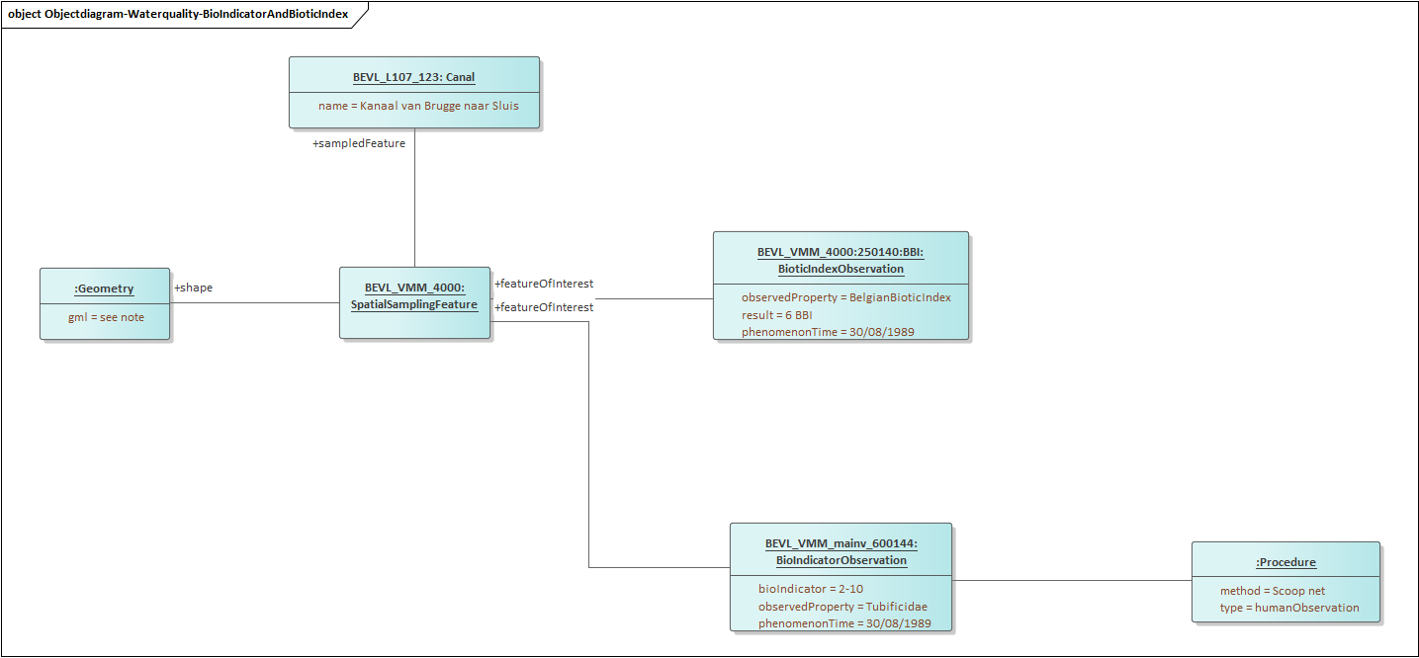
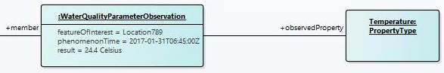
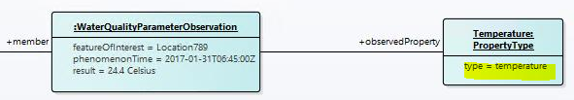
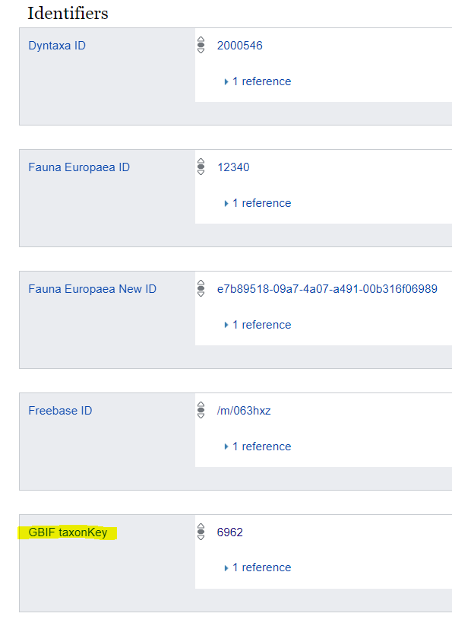
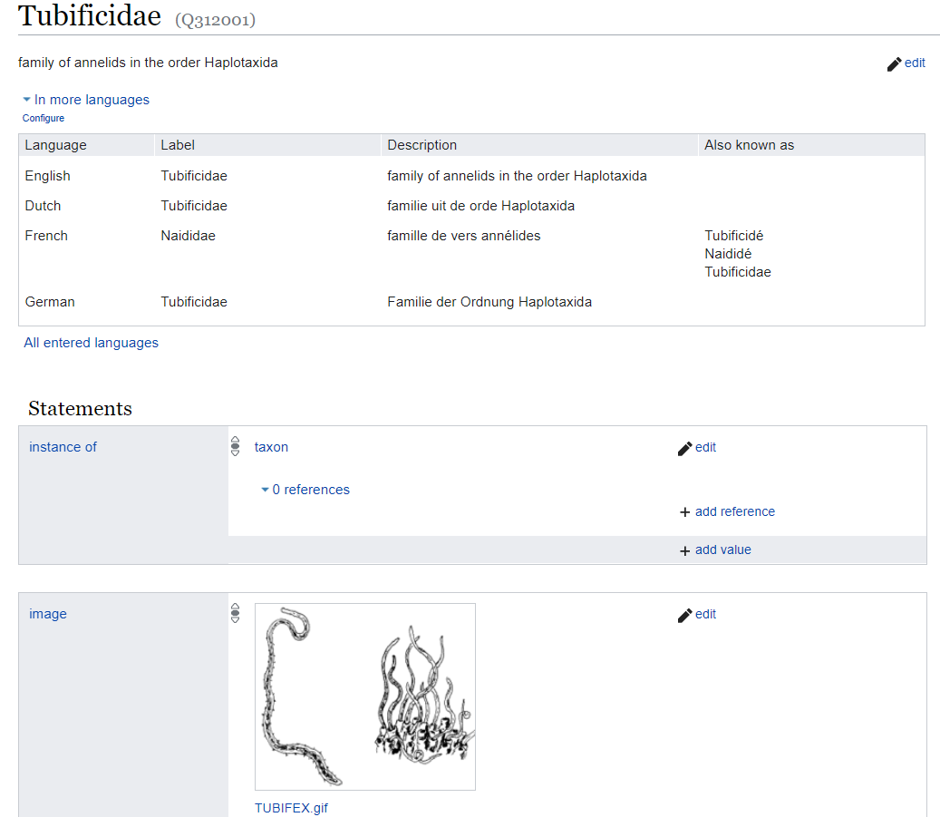
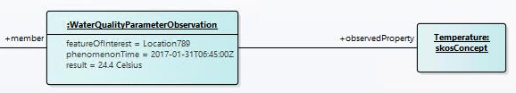
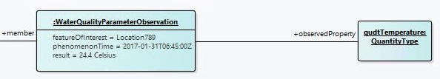
1
observedProperties
Multiple ways to include this in the model:
PropertyType as a generic property class
Same, but with the possibility to specify the type
Subsitution of PropertyType by a virtual subclass like skos:Concept or some other class from a suitable vocabulary (like qudt:QuantityType)
https://www.wikidata.org/wiki/Q312001

Slide 12

1
observedProperties
Ultimately:
Using wikidata allows to link to specific ObervableProperties (physical, chemical & biological)
Wikidata also includes the identifiers of the other alternatives
PubChem
GBIF
CAS
…
Do we use wikidata for detailing the ObservedProperties?
https://www.wikidata.org/wiki/Q312001
Do you agree or disagree?

Slide 13
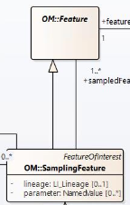
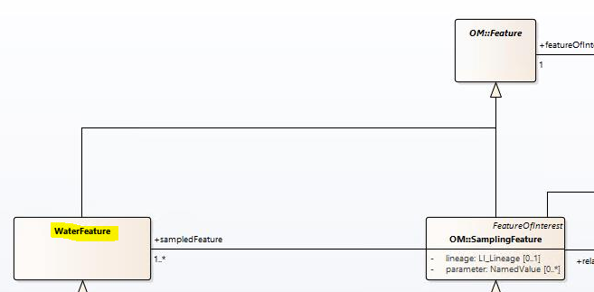
2
SampledFeature
Current model specified Sampling Feature from abstract class OM::Feature
However with this we don’t specify exactly which ‘domain feature’ we’re sampling (i.e. are we sampling a lake, river, …?)
Proposed change 1
Make a distinction between Sampling Feature & Domain Feature (AirFeature or WaterFeature) so we can specify exactly what type of water or air feature we’re measuring
It will be important to properly define (definition) what Water- and AirFeature mean
-> We believe we need to make distinction between Sampling Feature & Domain feature
Do you agree or disagree?

Slide 14
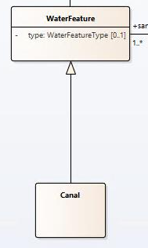
2
SampledFeature
Addition of AirFeature or WaterFeature is however not enough…
Therefore we believe that the model should allow to:
Be able to specify the WaterFeatureType; and
Be able to create instances of a subclass to specify the object we’re sampling
Proposed change 2:
We would allow the model to accommodate both options
This means however we’d also need to know which types of Air- and WaterFeatures are allowed in the model. Do we:
Create our own codelist
Specify in the usage notes which is the preferred list of Feature types
Do you agree or disagree?
(1)
In case of (2) additional attributes could be added to the instance of the ‘WaterFeature’
Which option is preferred?
Codelist
Specify in usage note
(2)

Slide 15
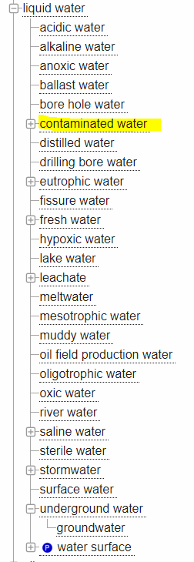
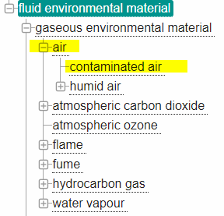
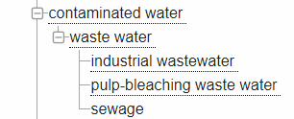
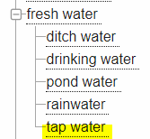
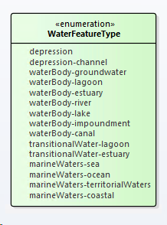
2
SampledFeature
The Environment Ontology (ENVO)
AIR
Combination WISE & HY_Hydrofeature
WATER

Slide 16
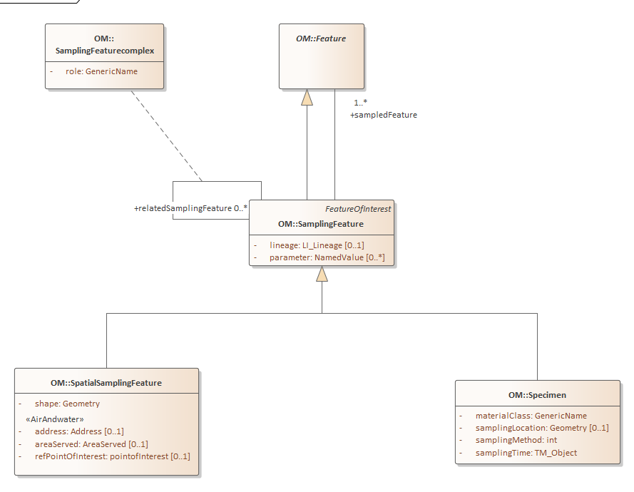
3
SamplingFeature
Our recommendation:
Add OM::Specimen to the model to be able to point towards specific specimens taken
We also understood that there should be a distinction between SpatialSamplingFeatures & the actual samples that were taken to e.g. the lab
The WISE model allows pointing towards physical samples creating two classes:
SpatialSamplingFeatures
Specimens
In SOSA they go even more into detail by adding:
SOSA:Sampling - the activity of the sampling
SOSA:Sampler - the specific instruments used
Do you agree or disagree?

Slide 17
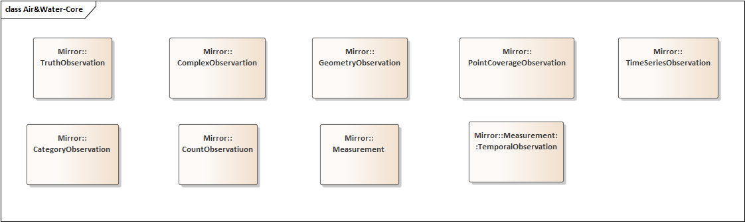
4
Observation subtypes
We suggest to expand Observations with other subtypes on top of Measurements:
Measurement (value + unit)
CategoryObservation (classification)
CountObservation (count)
TruthObservation (boolean)
TemporalObservation (when does the observed characteristics occur)
GeometryObservation (where does the observation occur)
ComplexObservation (complex results)
DiscreteCoverageObservation (temporal or spatial coverage)
Solution:
In the air & water models we will reuse the ‘Measurement’ and ‘CategoryObservation’ subtypes
We will also add the remaining classes in the model so they can be reused
Do you agree or disagree?

Slide 18
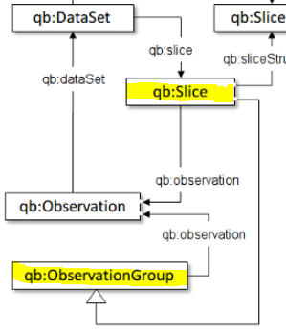
5
ObservationCollection
Last workshop we clarified there was a need for grouping observations and added the observationcollection to the model. Additionally Cube was also mentioned. This leaves us ultimately with two alternatives to group observations:
Via a Cube:datasets (as presented earlier) and it’s qb:Slices (1 dimension-datasets) or,
Via SOSA extensions which applies the same concept but through ObservationCollections, which is already a part of our core model.
Proposed solution:
In Cube, qb:Slice is a subclass of qb:ObservationGroup which seems to correspond with SOSA:ObservationCollection
Therefore we can include qb:Slice as a subclass of SOSA:ObservationCollection in case there is a practical need for qb:slice
Include qb:Slice or not?

Slide 19
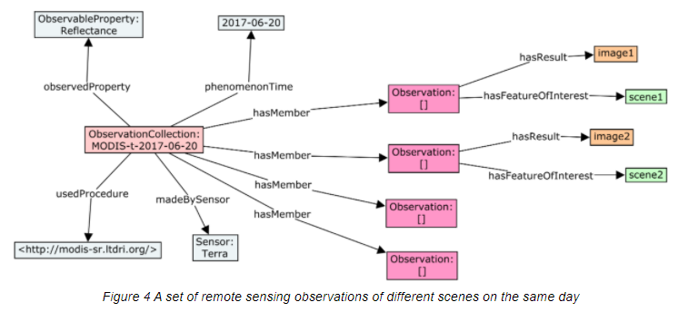
5
ObservationCollection
Object diagram
General example of using ObservationCollection

Slide 20
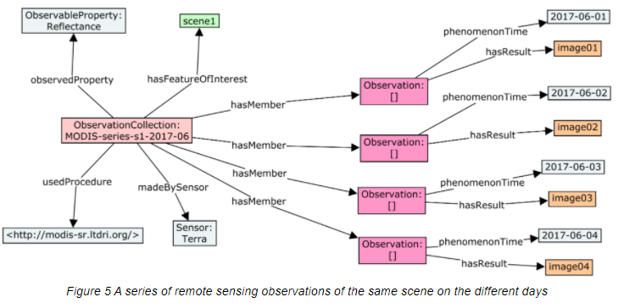
5
ObservationCollection
Object diagram
Using ObservationCollection to show timesereis

Slide 21
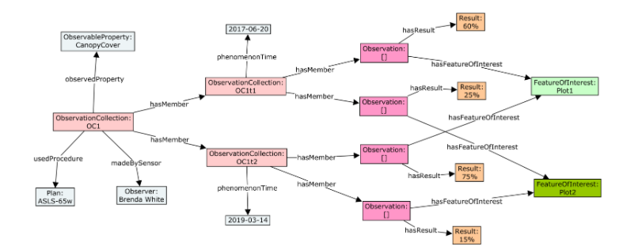
5
ObservationCollection
Object diagram
Nested Collections

Slide 22
Changes to the model since TW2
Core - Air - Water

Slide 23
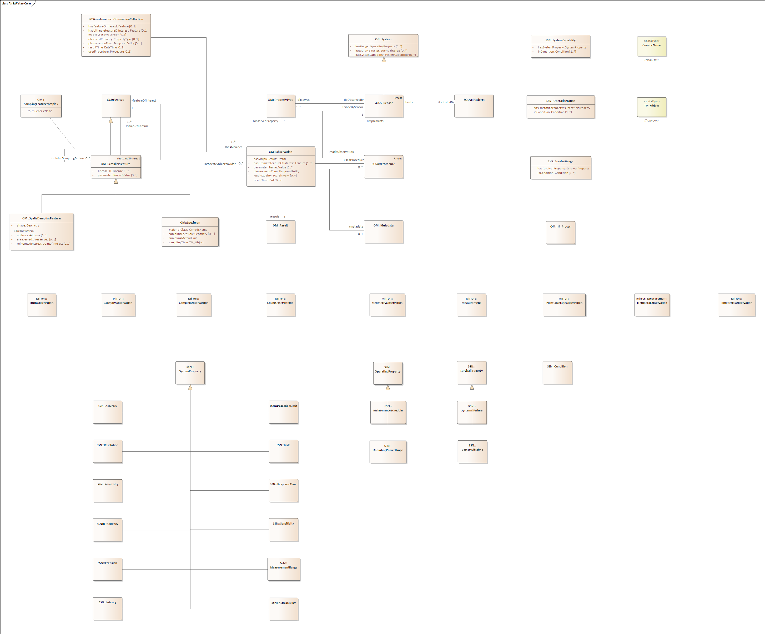




Core Model
Observation
Sensor
Sampling
Metadata

Slide 24
Core Model (1) Sampling
Addition of OM::Specimen class In order to link to SpatialSampling feature as well as a specific specimen that one would want to take to the lab
Addition of OM::SamplingFeaturecomplex This way we can link associated Spatial sampling features and specimens with one another.
2
1
SamplingFeature

Slide 25
Core Model (2) Observation
Addition of the different observation subtypes in so other types of observations can be made as detailed in ISO O&M
Observation subtypes

Slide 26
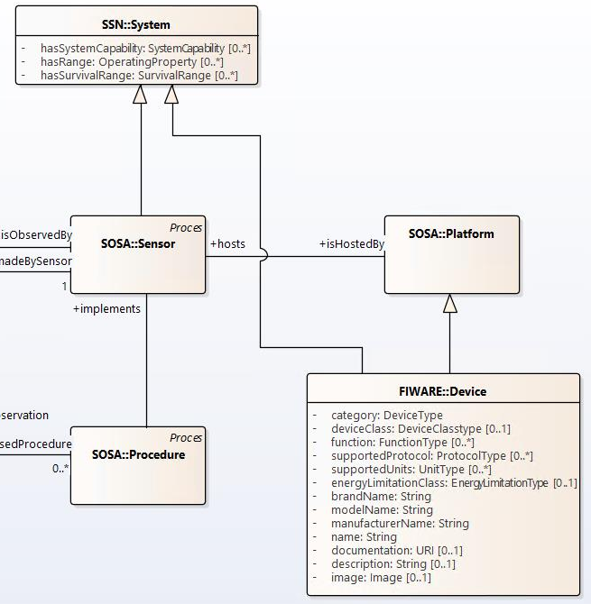
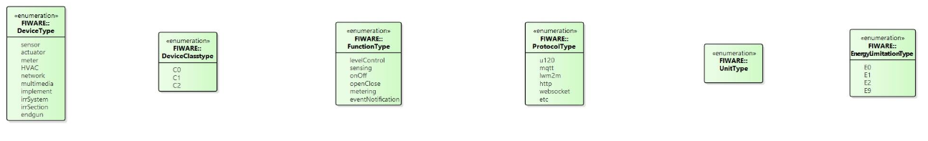
Core Model (3) Sensor
Initially FIWARE:Device was added to the model & analysis was done on the attributes that could be included for System & platform
A device could however both be a system and a platform and thus we decided against adding this to the model.

Slide 27
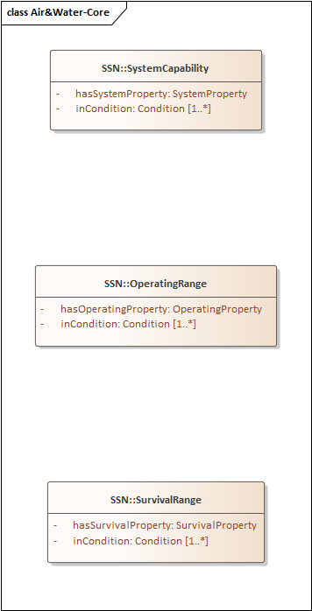
Core Model (3) Sensor
Therefore the FIWARE::Device class was removed in the new version of the model thus simplifying the model

Slide 28
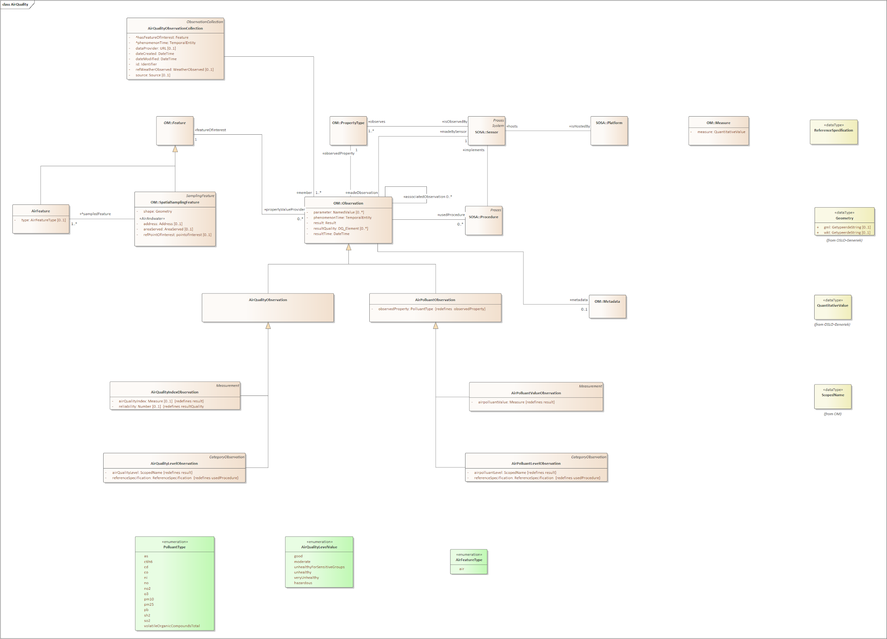
Air Model
Observation
Sensor
Sampling
Metadata

Slide 29
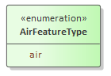
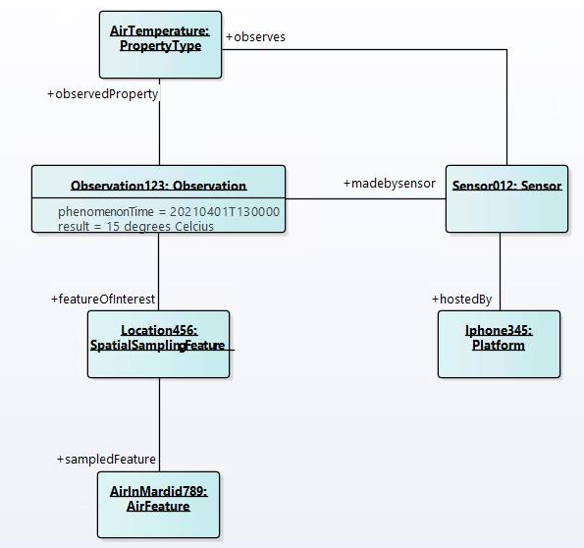
Air Model (1) Sampling
AirFeature in order to give more information on the actual feature type we’re observing and not only the spatial sample or specimen
Currently only ‘Air’ as subtype. Other ENVO for example also specifies ‘contaminated air’
SampledFeature

Slide 30
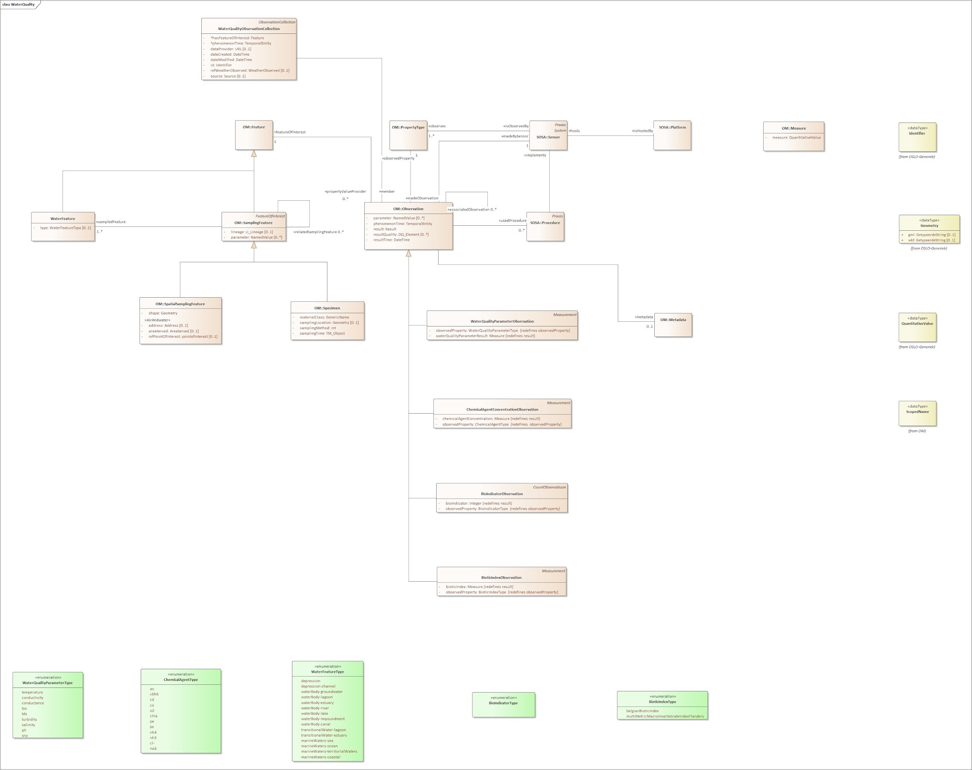
Water Model
Observation
Sensor
Sampling
Metadata

Slide 31
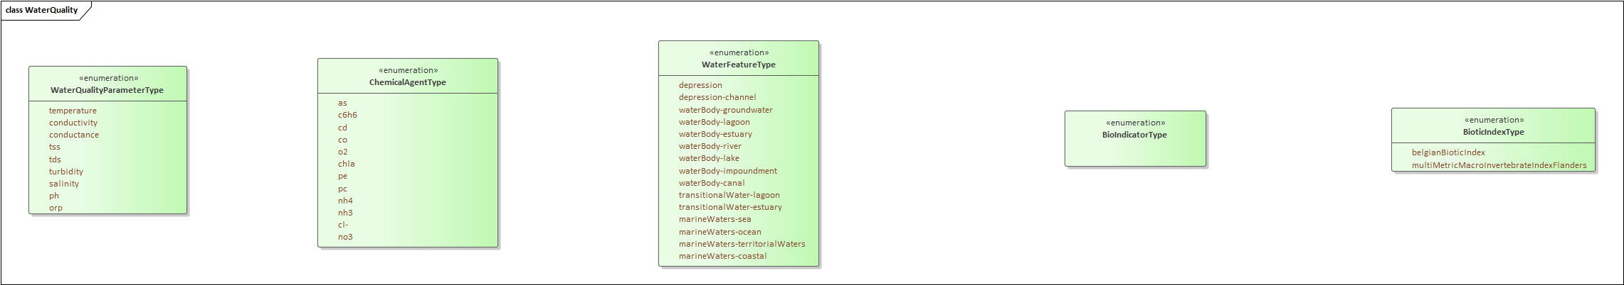
Water Model (1) Sampling
Similar to air, we also specified a WaterFeature where we’ll be able to specify which type of water feature is being observed
The current list in the model is a codelist that was derived from a combination between WISE & OGC HY
As illustrated earlier this water feature can be typed by a codelist or by instancing a subclass of the WaterFeature of a specific kind (like in the example of the canal)
SampledFeature

Slide 32
Water Model (2) Observation
Specifically for water there was also the need to observe biological properties. Therefore we have added the BioIndicatorObservation (countObservation) as well as the BioIndexObservation (Measurement)

Slide 33
Open Questions
To Do
Does SpatialSamplingFeature suffice as a SamplingFeature for AirQuality or do we also need Specimen?
Research What is water quality?
Remove fitness for purpose from the model. Indicators are potentially indicators for different kinds of ‘quality’. For example pH can be important for drinkability of water as well as for fishing
Focus of this Applicationprofile is mainly the environmental aspects and therefore adding biological indicators are needed
Emissiepunten: Do we solve emission points by being able to refer to contaminated water or air

Slide 34
Exercise Attributes

Slide 35
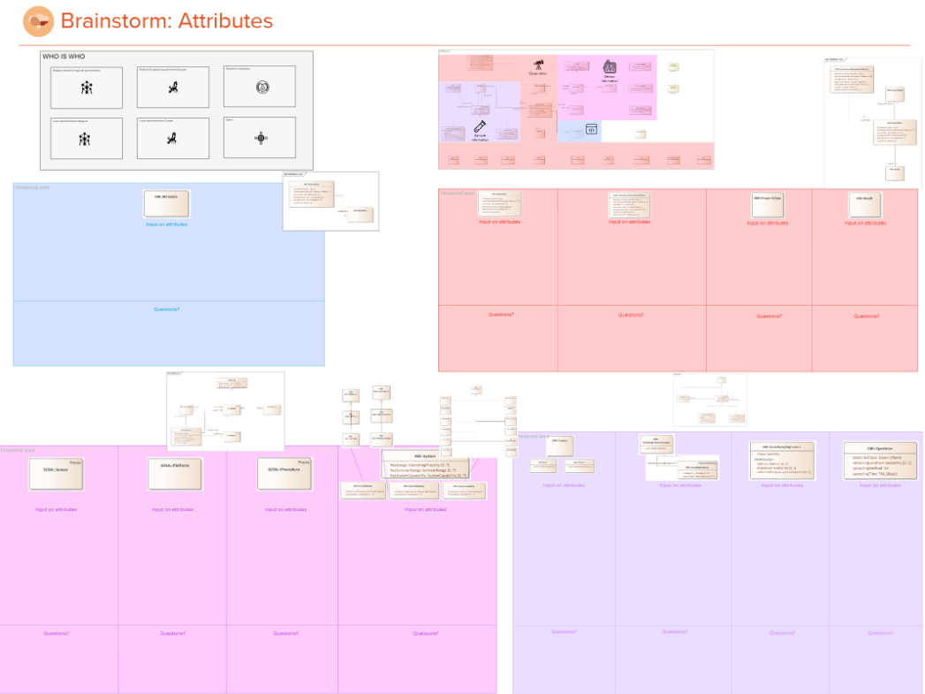
Mural Brainstorming: Attributes (60’)
In this exercise we would like to capture your input on attributes for the Core - Air - Water models
You will be able to add post-its for each of the classes with suggestions for attributes (adding or removing existing attributes)
You will also be able to add questions to specific classes if relevant
Notes:
LINK TO MURAL:
https://app.mural.co/t/beadvtc7549/m/beadvtc7549/1617019110779/e542a4d6a6ea51377ef244c8368b807413edc533
LINK TO SHARE

Slide 36
Definitions
Notes:
Kevin

Slide 37
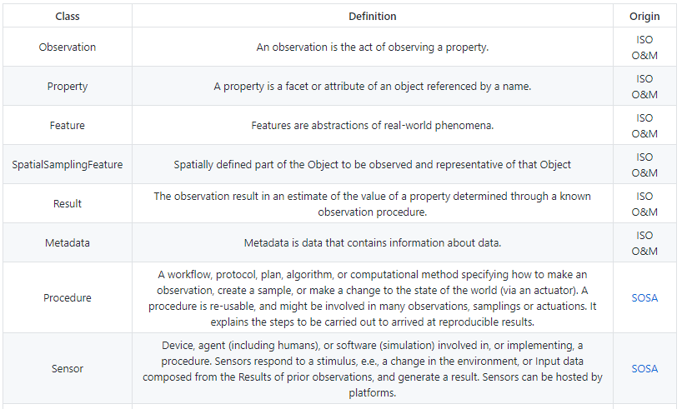
Definitions
Origin of definition
Definitions have been added for a couple of weeks to Github and no issues have been logged for any of the definitions yet. Can we assume that the definitions for the main classes are accepted by the group?
Do you agree or disagree?

Slide 38
Next steps

Slide 39


Next Steps
Generate specs as soon as possible & forward url
Please provide input on the specs one Github by adding an ‘issue’
Will be used as input for TW4
Section on technical implementation
Json-ld schema (een technische)
Ngsi-ld

Slide 40

Feedback & collaboration
Feedback can be provided by email to the following people:
kevin.haleydt@vlaanderen.be
Feedback/input can be provided through GitHub: https://github.com/Informatievlaanderen/OSLOthema-airAndWater

Slide 41
Issues logged on Github
https://github.com/Informatievlaanderen/OSLOthema-airAndWater

Slide 42

Are there any questions left?

Slide 43
Thanks!

